Slide 1


Elevating Quality: Web Automation Project
Welcome to the Web Automation Project. This presentation outlines our journey to enhance testing efficiency and reliability for our e-commerce platform.

Slide 2


Chapter 1
Introduction to the Project
What is Web Automation?
Why Automation?
Main Goals
To achieve faster feedback, consistent results, and greater test coverage.
Saving time, reducing human errors, and significantly increasing overall efficiency.
Automating repetitive web tasks to streamline testing processes.

Slide 3
Chapter 2
Tools & Technologies
Selenium WebDriver
Java
The core framework for browser automation.
Our chosen programming language for robust test scripts.
TestNG
Maven
manages test cases by using assertions, reports, annotations, grouping, and test execution control.
For manages project dependencies and downloads required libraries
Allure Reports
For comprehensive and interactive test reporting.

Slide 4

Chapter 3
Website Under Test: An E-commerce Platform
Swag Labs
Swag Labs is a demo e-commerce website designed for testing and automation practice. It includes features like login, product listing, shopping cart, checkout, and order completion.
Key Pages Tested:
Login Page: Secure user access.
Products Page: Display and filtering of items.
Product Details Page: In-depth product information.
Cart Page: Managing selected items.
Checkout Page: Completing the purchase process.
You can visit the website from here: Swag Labs

Slide 5
Chapter 4
Crucial Test Scenarios
1
2
3
User Login & Authentication
Product Interaction & Cart Management
Detailed Product Views
Verifying product details, images, and specifications on the product page.
Testing valid and invalid login credentials, ensuring secure access.
Adding items to the cart and removing products.
4
5
Checkout Process & Form Submission
Message Validation
End-to-end testing of the checkout flow, including shipping and payment forms.
Confirming success and error messages are displayed correctly.

Slide 6




Chapter 5
Project Architecture: Page Object Model
Our project is structured using the Page Object Model (POM) architecture, promoting maintainability and reusability.
Packages
Page Classes
Organizing code logically by feature or type.
Representing each web page's elements and actions.
Utility Classes
Test Classes
Handling common functionalities like waits, browser setup, and screenshots.
Containing the actual test scenarios and assertions.

Slide 7


Chapter 6
Behind the Scenes: How Automation Works
Browser Launch & Configuration
Automatically launching and configuring web browsers for testing.
Element Location (Locators)
Using robust locators (ID, XPath, CSS Selectors) to interact with UI elements.
Intelligent Waits
Applying implicit and explicit waits to handle dynamic page loading.
Assertions & Validations
Verifying expected outcomes and data integrity throughout the tests.

Slide 8

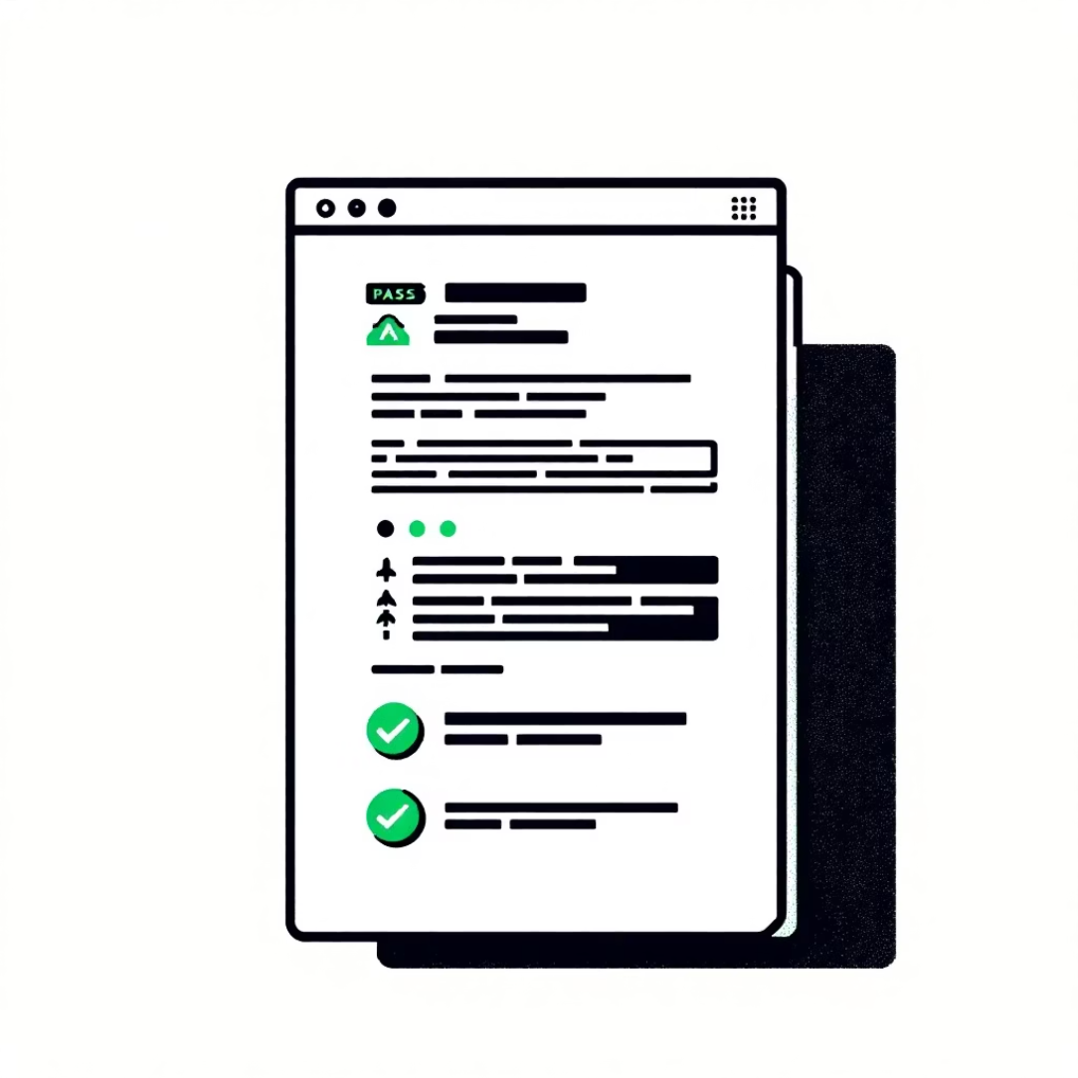

Chapter 7
Comprehensive Reporting
Our automation framework provides detailed reports for clear insights into test execution.
Allure Reports
Test Logging & Insights
Screenshots on Failure
Interactive, detailed reports with test steps, timings, and attachments.
Test logs provide clear, real-time insights into test progress and failures
Automatically capturing screenshots for quick debugging and issue identification.

Slide 9


Chapter 8
Project Outcomes & Results
100%
55
0
Test Coverage
All 55 automated tests passed successfully
Flaky Tests
Achieved 100% test coverage: all 55 test cases automated and verified
All tests stable on multiple runs
Our automation project has demonstrably improved the efficiency and reliability of our testing processes, freeing up valuable time for exploratory testing and feature development.

Slide 10

THANK YOU

